Slide 1

SAP BTP CAPM “TypeScript” for Developers
DAY-2
Anubhav Oberoy
www.AnubhavTrainings.com
Follow excellence with sheer passion

Slide 2


DISCLAIMER
The training content and delivery of this presentation is confidential, and cannot be recorded, or copied and distributed to any third party, without the written consent of Anubhav Trainings

Slide 3
Agenda
01
Understanding sample project
02
Incremental migration
03
Migrate cap logic and units
04
Generic decorators and utility
www.anubhavtrainings.com

Slide 4

Course Outlook – 10 Hours
Type Script Basics for Transition
CI/CD pipeline & TypeScript-aware deployment
CAP in Type Script
SAP Cloud SDK & Fiori/UI5 in TypeScript
This module covers only the TypeScript concepts that do not exist in JavaScript.
It focuses entirely on what changes when moving an existing CAP JavaScript project to TypeScript.
This module covers the TypeScript-specific changes for two distinct areas: backend API consumption using the SAP Cloud SDK, and frontend Fiori/UI5 development
The final module covers the deployment pipeline changes needed to support TypeScript in an existing BTP project.
www.anubhavtrainings.com

Slide 5

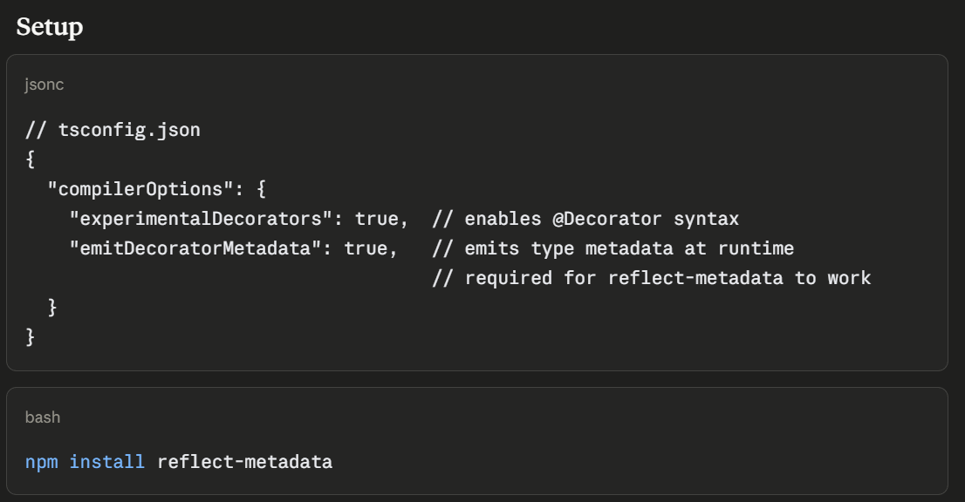
Decorators and Metadata reflection
Decorators are special functions prefixed with @ that attach to classes, methods, properties, or parameters and add behavior without modifying the original code — similar to Java Annotations or Python Decorators.
Metadata Reflection (reflect-metadata) lets decorators read/write hidden metadata about classes at runtime — used heavily by frameworks like NestJS, TypeORM.
7
www.anubhavtrainings.com
7

Slide 6
Utility types
Utility types are built-in generic types that transform existing types into new ones — no need to rewrite interfaces from scratch.
They're like type factories—you feed in a type, and out comes a new type with different properties.
Think of it like this: if you have a blueprint for a house, utility types let you create variations—a blueprint with fewer rooms, optional walls, readonly doors, etc.—without rewriting everything from scratch.
7
www.anubhavtrainings.com
7

Slide 7
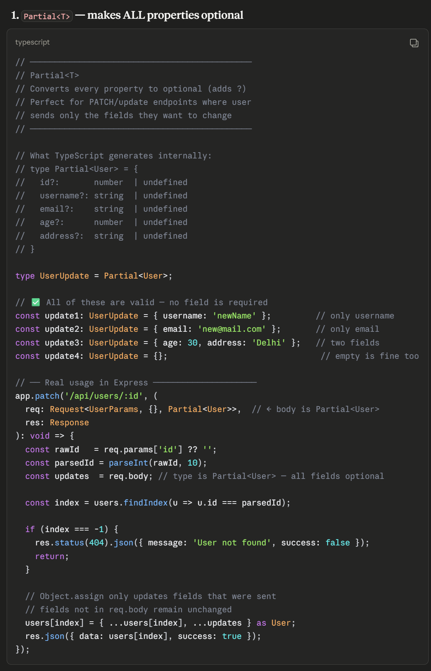
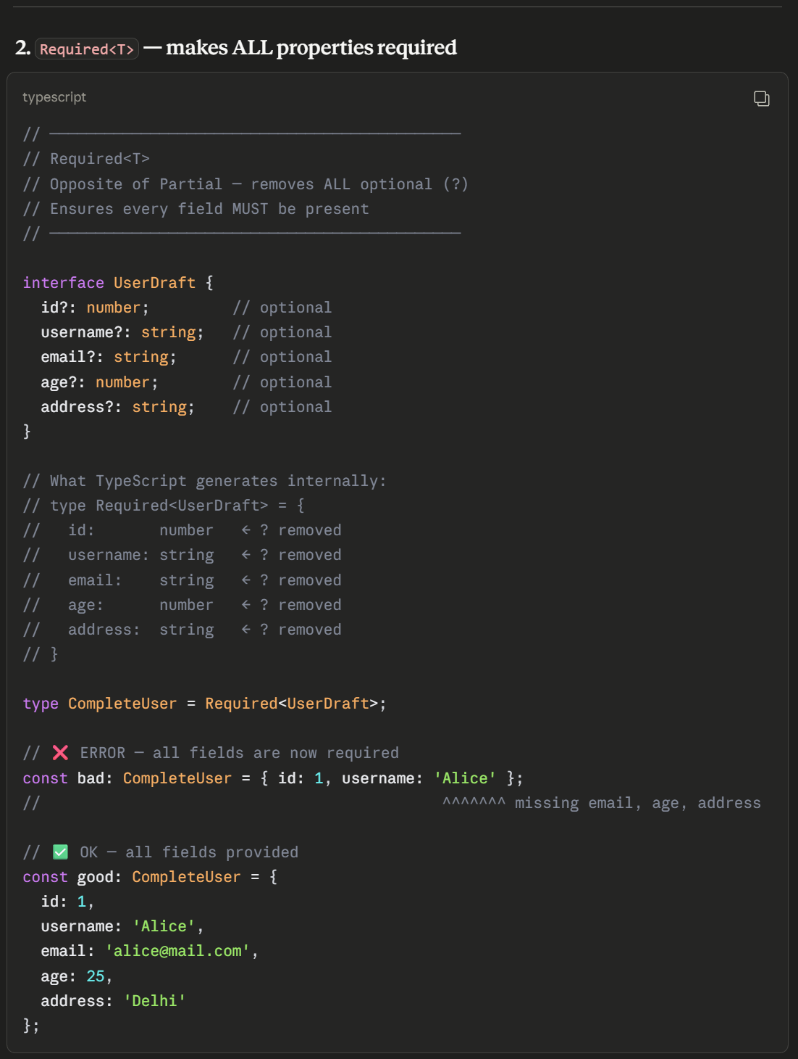
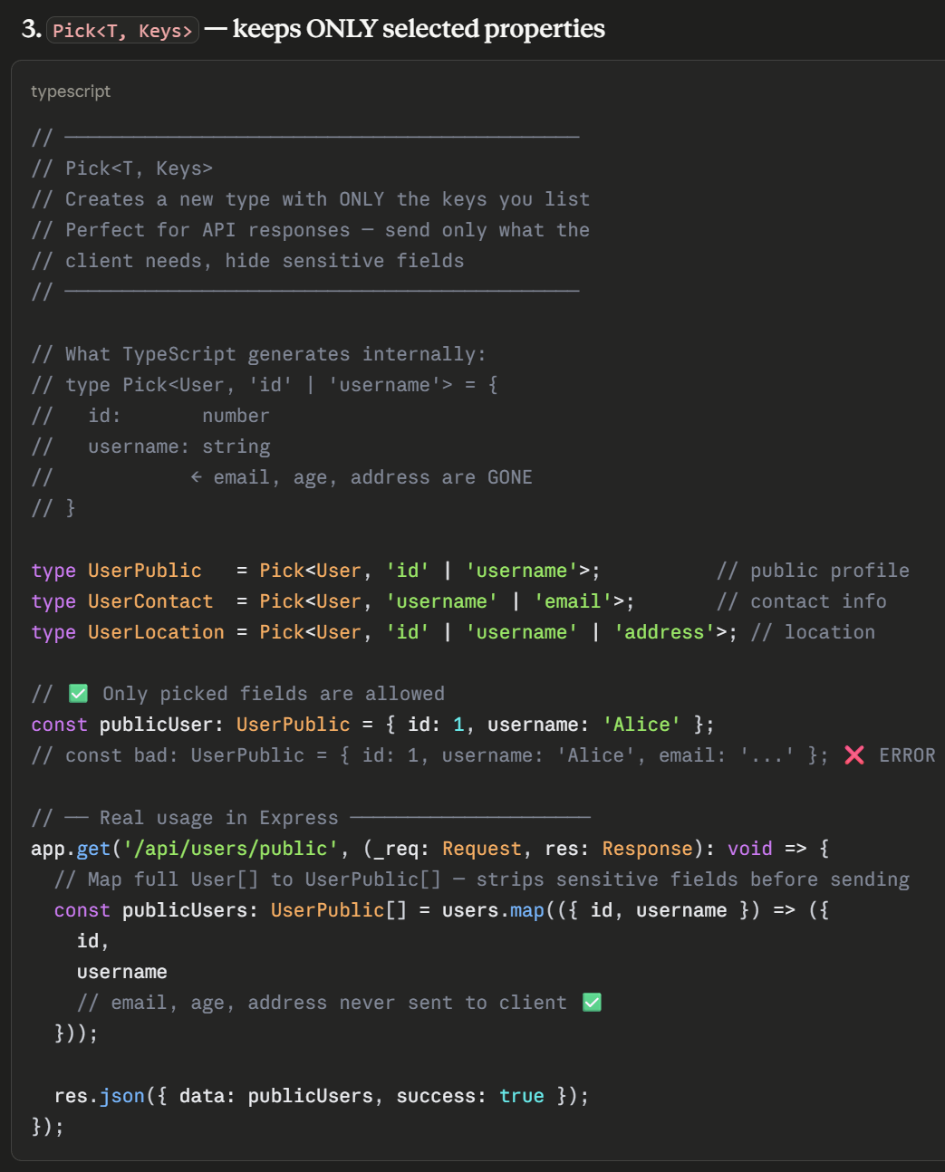
Partial, Required, Pick
Text
7
www.anubhavtrainings.com
7

Slide 8
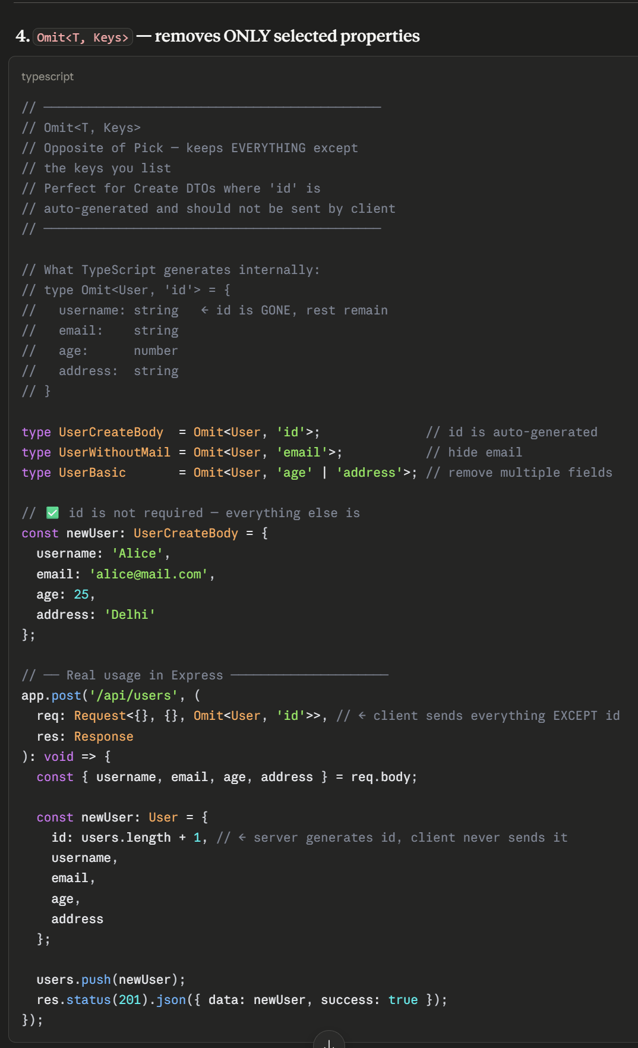
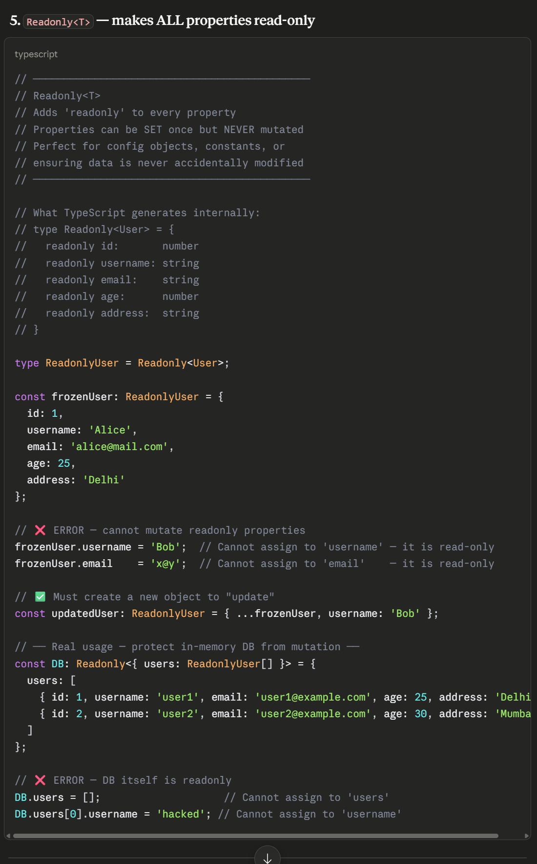
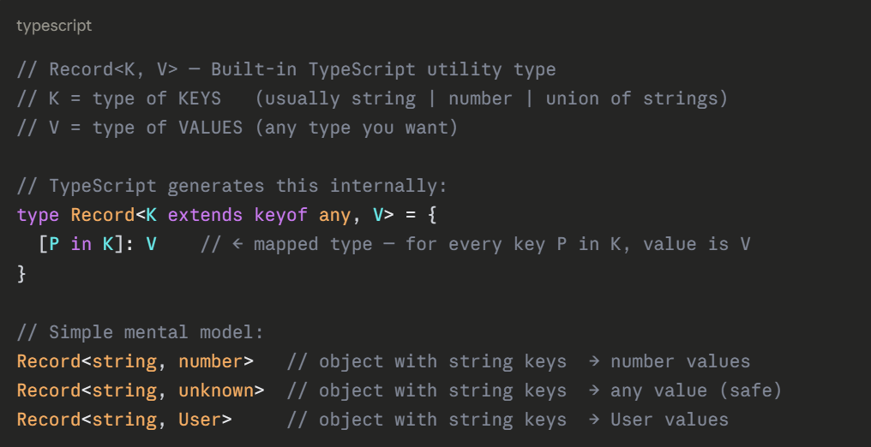
Omit and ReadOnly
7
www.anubhavtrainings.com
7

Slide 9
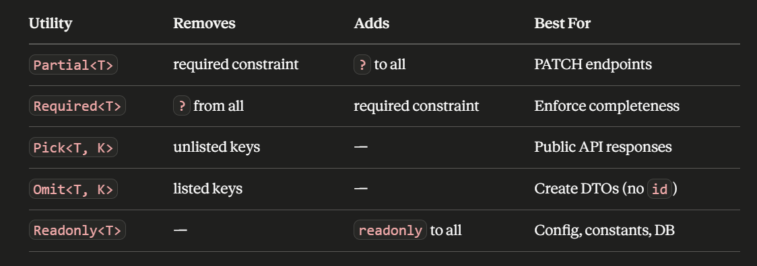
Summary
7
www.anubhavtrainings.com
7

Slide 10
Decorators and Metadata reflection
Decorators are special functions prefixed with @ that attach to classes, methods, properties, or parameters and add behavior without modifying the original code — similar to Java Annotations or Python Decorators.
Metadata Reflection (reflect-metadata) lets decorators read/write hidden metadata about classes at runtime — used heavily by frameworks like NestJS, TypeORM.
7
www.anubhavtrainings.com
7

Slide 11
Utility types
Utility types are built-in generic types that transform existing types into new ones — no need to rewrite interfaces from scratch.
They're like type factories—you feed in a type, and out comes a new type with different properties.
Think of it like this: if you have a blueprint for a house, utility types let you create variations—a blueprint with fewer rooms, optional walls, readonly doors, etc.—without rewriting everything from scratch.
7
www.anubhavtrainings.com
7

Slide 12
Partial, Required, Pick
Text
7
www.anubhavtrainings.com
7

Slide 13
Omit and ReadOnly
7
www.anubhavtrainings.com
7

Slide 14
Summary
7
www.anubhavtrainings.com
7

Slide 15
TS
SAP BTP CAP · TypeScript Migration · Complete Course
JavaScript → TypeScript Incremental Migration of SAP BTP CAP Projects
tsconfig.json
strict mode
CDS Types
CatalogService
Branded Keys
Null-safe calls
Jest Tests
Complete Guide

Slide 16







Learning Objectives — Complete Migration Path
Install & Configure TS in CAP
Migrate Utility Files
npm packages, @cap-js/cds-types, tsconfig.json tuned for CAP Node.js projects
payload-transformer.ts and error-mapper.ts with full interfaces and strict types
Migrate CAP Service Handlers
Define OData Interfaces
CatalogService.js and CDSService.js generic handlers — typed CDS events & requests
OData payload shapes, error objects, and CDS entity interfaces
Branded Types for Entity Keys
Strict Null-Safe Service Calls
Prevent ID mix-ups at compile time using opaque/branded string types
Guard every cds.connect, service.run and request.data against null/undefined
Verify Without Rewriting
tsc --noEmit + unchanged Jest suite confirms all business logic is preserved

Slide 17
Starter Project Structure — Files to Migrate
All JS files involved · three layers: utilities, service handlers, and tests
📁 CAP Project Structure
tsconfig.json (NEW)
Configuration
› CAP-optimised compiler options
my-cap-project/
› strict + allowJs:false
├─ package.json
› @cap-js/cds-types path mapping
├─ tsconfig.json ← ADD
srv/CatalogService.js → .ts
Service Handler
├─ .cdsrc.json
├─ db/
› Typed CDS.Service class extension
│ └─ schema.cds ← no change
› cds.Request<T> parameter types
› Entity CRUD operation types
├─ srv/
│ ├─ CatalogService.js ⬅ migrate
srv/CDSService.js → .ts
Generic Handler
│ └─ CDSService.js ⬅ migrate
› Generic handler registration pattern
├─ utils/
› Typed event callbacks
│ ├─ payload-transformer.js ⬅ migrate
› Type-safe this.on() / this.before()
│ └─ error-mapper.js ⬅ migrate
utils/payload-transformer.js → .ts
Utility
└─ test/
› ODataResponse<T> generic interface
└─ utils.test.js ← must pass
› EntityRecord type alias
› Strict null checks on value

Slide 18
Task 1a Install TypeScript Dependencies for CAP
God of all commands: cds add typescript
1
2
3
4
5
Core TS
CAP Types
Test Types
ts-jest
Verify
Step 1 — Core TypeScript Packages
Step 3 — Jest & Testing Types
npm install --save-dev \
typescript \
@types/node \
ts-node
# typescript — the compiler (tsc)
# @types/node — Node.js built-in types
# ts-node — run .ts files directly
npm install --save-dev \
ts-jest \
@types/jest
# ts-jest — transpiles .ts test files for Jest
# @types/jest — describe/it/expect types
# No code changes to test files needed!
Step 2 — CAP-Specific Type Packages
Step 4 — package.json scripts
npm install --save-dev \
@cap-js/cds-types \
@sap/cds
# @cap-js/cds-types — official TS defs for:
# cds.Service, cds.Request,
# cds.ApplicationService, cds.connect
# @sap/cds — CAP runtime (if not installed)
"scripts": {
"build": "tsc --noEmit",
"typecheck":"tsc --noEmit --strict",
"start:ts": "ts-node srv/server.ts",
"test": "jest"
}
# Step 5: verify install
npx tsc --version # should print 5.x+
⚠ Install @cap-js/cds-types NOT @types/cds (deprecated). The official package ships cds.Request<T>, cds.Service, etc.

Slide 19
Task 1b tsconfig.json — Every Option Explained for CAP
Configuration · why each compiler option matters in a CAP Node.js context
Complete tsconfig.json for CAP
Why each option matters
{
"compilerOptions": {
"target": "ES2022",
"module": "commonjs",
"lib": ["ES2022"],
"strict": true,
"allowJs": false,
"esModuleInterop":true,
"skipLibCheck": true,
"moduleResolution":"node",
"outDir": "./dist",
"rootDir": "./",
"baseUrl": "./",
"paths": {
"@cds-models/*":["./srv/gen/*"]
},
"types": ["node","jest","@cap-js/cds-types"]
},
"include": ["srv/**/*","utils/**/*","test/**/*"],
"exclude": ["node_modules","dist","**/*.js"]
}
target: "ES2022"
CAP runs on Node 18+. ES2022 enables optional chaining, nullish coalescing, and top-level await natively.
module: "commonjs"
CAP uses require() at runtime. Must be commonjs — do NOT use ESM here or cds.connect() will break.
strict: true
Enables noImplicitAny, strictNullChecks, strictFunctionTypes — catches the most bugs at compile time.
allowJs: false
Forces all files to be .ts once migration is done. Set to true during incremental migration if needed.
skipLibCheck: true
Skips type checks inside node_modules — required because some CDS generated files have loose types.
"@cds-models/*"
Maps generated CDS model types (cds compile --to ts) to their import paths in service files.
types: [...cds-types]
Pulls in cds.Service, cds.Request, cds.ApplicationService global type declarations.

Slide 20
Task 2 utils/error-mapper.js → .ts
Error Interface Hierarchy · ODataError, NormalisedError, union ErrorCategory
Interface Definitions
Typed Implementation
// Shape of a raw CAP/OData error
interface ODataError {
code: string;
message: string;
innererror?: {
errordetails?: ErrorDetail[];
type?: string;
};
}
interface ErrorDetail {
code: string;
message: string;
target?: string;
severity?:'error'|'warning'|'info';
}
export interface NormalisedError {
status: number;
category: ErrorCategory;
message: string;
details: ErrorDetail[];
}
type ErrorCategory =
| 'NOT_FOUND' | 'VALIDATION'
| 'AUTHORIZATION' | 'SERVER_ERROR';
export function mapError(
status: number,
raw: ODataError
): NormalisedError {
const category = resolveCategory(status);
const details =
raw.innererror?.errordetails ?? [];
return {
status, category,
message: raw.message,
details
};
}
function resolveCategory(
status: number
): ErrorCategory {
if (status===404) return 'NOT_FOUND';
if (status===400) return 'VALIDATION';
if (status===403) return 'AUTHORIZATION';
return 'SERVER_ERROR';
}
💡 Union types for ErrorCategory prevent invalid strings. Optional chaining (?.) and nullish coalescing (??) handle the nested innererror safely under strict mode.

Slide 21
Task 3 utils/payload-transformer.js → .ts
Utility Migration · ODataResponse<T>, EntityRecord, strict null guards
❌ Before (JavaScript)
✅ After (TypeScript)
// utils/payload-transformer.js
function flattenODataResponse(response) {
if (!response || !response.value) {
return [];
}
return response.value.map(entity => {
return mapEntity(entity);
});
}
function mapEntity(entity) {
const result = {};
for (const key of Object.keys(entity)) {
if (!key.startsWith('@')) {
result[key] = entity[key];
}
}
return result;
}
module.exports = { flattenODataResponse };
// utils/payload-transformer.ts
interface ODataResponse<T> {
value?: T[];
'@odata.context'?: string;
'@odata.count'?: number;
}
type EntityRecord = Record<string, unknown>;
export function flattenODataResponse<
T extends EntityRecord
>(response: ODataResponse<T>): EntityRecord[] {
if (!response?.value) return [];
return response.value.map(mapEntity);
}
function mapEntity(entity: EntityRecord)
: EntityRecord {
return Object.fromEntries(
Object.entries(entity)
.filter(([k]) => !k.startsWith('@'))
);
}
ODataResponse<T>
EntityRecord
flattenODataResponse<T extends EntityRecord>
response?.value
Generic — value array typed by T
Record<string, unknown> alias
Constrained generic, explicit return
Optional chaining — strictNullChecks guard

Slide 22
Task 4a srv/CatalogService.js → .ts — Concept & CDS Types
Handler Migration · understanding the CDS type system before writing code
CDS Type Hierarchy (from @cap-js/cds-types)
cds.Service
cds.ApplicationService
cds.RemoteService
Your CatalogService extends
cds.Request<Data>
cds.connect.to()
cds.ApplicationService
cds.Request<Data>
cds.connect.to()
The base class for all CAP service implementations. Your CatalogService MUST extend this. Provides this.on(), this.before(), this.after(), this.send().
Generic type for every incoming request. Data is the shape of req.data. Also carries req.user, req.locale, req.params — all typed.
Returns Promise<cds.Service>. Use with await and assign to a typed variable. Strict null checks require null-guards before calling methods on it.

Slide 23
Task 4b CatalogService.js → .ts — Full Before/After
Code Migration · adding CDS types to a typical CRUD service handler
❌ Before (CatalogService.js)
✅ After (CatalogService.ts)
const cds = require('@sap/cds');
module.exports = class CatalogService
extends cds.ApplicationService {
async init() {
// no types — all implicit any
this.on('READ', 'Books', req => {
return this.books(req);
});
this.on('CREATE','Orders', req => {
return this.createOrder(req);
});
return super.init();
}
async books(req) {
const { ID } = req.data; // any
return SELECT.from('Books')
.where({ ID });
}
async createOrder(req) {
const order = req.data; // any
return INSERT.into('Orders').entries(order);
}
};
import cds from '@sap/cds';
// CDS-generated entity interfaces
interface Book { ID: string; title: string; }
interface Order { ID: string; book_ID: string;
amount: number; }
export default class CatalogService
extends cds.ApplicationService {
async init(): Promise<void> {
this.on('READ','Books',
(req: cds.Request) => this.books(req));
this.on('CREATE','Orders',
(req: cds.Request) => this.createOrder(req));
return super.init();
}
async books(req: cds.Request): Promise<Book[]> {
const { ID } = req.data as { ID: string };
return SELECT.from('Books').where({ ID });
}
async createOrder(
req: cds.Request
): Promise<Order> {
const order = req.data as Order;
return INSERT.into('Orders').entries(order);
}
}

Slide 24
Task 4c srv/CDSService.js → .ts — Generic Handler Pattern
Generic Migration · typed this.on/before/after with reusable handler registration
Pattern: CDSService.js is a generic bootstrap file that registers handlers for multiple entities. The migration challenge is typing the handler callbacks — specifically the req: cds.Request parameter and return types for each entity operation.
❌ Before (CDSService.js — generic handler)
✅ After (CDSService.ts — fully typed)
const cds = require('@sap/cds');
// Generic handler — no type info
module.exports = class CDSService
extends cds.ApplicationService {
async init() {
// this.before — no req type
this.before('*', '*', req => {
if (!req.user.is('authenticated'))
req.reject(403,'Unauthorized');
});
this.after('READ', '*', (data, req) => {
// data is any — no safety
console.log(data.length);
});
return super.init();
}
};
import cds from '@sap/cds';
type Handler<D=unknown> = (
req: cds.Request<D>
) => Promise<void> | void;
export default class CDSService
extends cds.ApplicationService {
async init(): Promise<void> {
// before: req is cds.Request
this.before('*','*',
(req: cds.Request): void => {
if (!req.user?.is('authenticated'))
req.reject(403,'Unauthorized');
});
// after: data is typed array
this.after('READ','*',
(data: unknown[], req: cds.Request) => {
console.log(data.length); // safe
});
return super.init();
}
}
💡 Key difference: this.before receives cds.Request; this.after receives (data, req) where data is the returned array. Both must be explicitly typed.
Handler<D> Reusable typed callback alias — avoids repeating cds.Request<D> everywhere
this.before() Typed as (event, entity, callback) — callback always gets cds.Request
req.user?.is() Optional chain required in strict mode — req.user can be null for anonymous requests

Slide 25
Task 5 Diagnose & Fix Common CAP Migration Type Errors
Diagnostics · real error codes you will see when migrating CAP handlers
TS7006
Parameter implicitly has an 'any' type
TS2339
Property 'data' does not exist on type 'never'
❌ async books(req) { ... }
❌ this.on('READ','Books', req => { req.data })
✅ async books(req: cds.Request): Promise<Book[]> { ... }
✅ this.on('READ','Books', (req: cds.Request) => { req.data })
TS2532
Object is possibly 'undefined'
TS2345
Argument of type 'any' not assignable to 'Book'
❌ const { ID } = req.data; // data may be undefined
❌ return INSERT.into('Books').entries(req.data);
✅ const { ID } = (req.data ?? {}) as { ID: string };
✅ return INSERT.into('Books').entries(req.data as Book);
TS2304
Cannot find name 'SELECT' / 'INSERT'
TS2554
Expected 2 arguments but got 1
❌ // No global CQL types — CAP's SELECT is global
❌ await cds.connect.to('destination');
✅ Add "@cap-js/cds-types" to tsconfig types array
✅ const svc: cds.Service = await cds.connect.to('destination');

Slide 26
Task 6a Branded Types for Entity Keys — The Problem
Concept · why plain 'string' IDs are dangerous in BTP services
Problem: In a BTP service with multiple entity types (Books, Orders, Customers), every primary key is typed as string. TypeScript will not stop you from passing a BookId where an OrderId is expected — both are just strings. This silently corrupts data.
The Bug — TypeScript doesn't catch this:
With Branded Types — caught at compile time:
// All IDs are just 'string'
async function getOrder(orderId: string) {
return SELECT.from('Orders')
.where({ ID: orderId });
}
const bookId = '4a7b-...'; // Book's ID
await getOrder(bookId);
// ❌ No error! Wrong ID — silent bug
// OrderId and BookId are distinct types
async function getOrder(id: OrderId) {
return SELECT.from('Orders')
.where({ ID: id });
}
const bookId = '4a7b-...' as BookId;
await getOrder(bookId);
// ✅ ERROR: BookId not assignable to OrderId!
What is a branded type?
Zero runtime cost
BTP use cases
A branded (opaque) type is a string (or number) with a phantom type tag that makes it structurally distinct from other strings — even though at runtime they are identical.
Branded types are purely a compile-time construct. After tsc runs, the generated JS has no trace of them — no wrappers, no classes, no overhead.
Entity IDs (BookId, OrderId, CustomerId), GUID keys, UUID fields, correlation IDs, tenant IDs — any string that should not be freely interchangeable.

Slide 27
Task 6b Branded Types — Implementation & Usage in CAP
Code · three patterns from simple brand to type-safe factory function
Pattern 1 — Declare in entity-keys.ts
Pattern 2 — Use in Entity Interfaces
// entity-keys.ts — single source of truth
// The __brand trick: phantom field never set
declare const __brand: unique symbol;
type Brand<B, T> = T & { [__brand]: B };
// One line per entity key type
export type BookId = Brand<'BookId', string>;
export type OrderId = Brand<'OrderId', string>;
export type CustomerId = Brand<'CustomerId', string>;
// Type-safe cast factory
export const asBookId =
(s: string): BookId => s as BookId;
import { BookId, OrderId } from './entity-keys';
interface Book {
ID: BookId; // branded, not string
title: string;
stock: number;
}
interface Order {
ID: OrderId; // distinct from BookId!
book_ID: BookId; // references Book
amount: number;
}
Pattern 3 — Type-Safe Handler Usage
Compiler catches wrong ID:
async findBook(id: BookId): Promise<Book|null> {
return SELECT.one.from('Books').where({ID:id});
}
// Reading from req.data — cast once at boundary
const id = asBookId(req.data.ID as string);
const book = await findBook(id); // ✅ typed
const orderId = '...' as OrderId;
await findBook(orderId);
// TS2345: Argument of type 'OrderId' is not
// assignable to parameter of type 'BookId'.
// ✅ Bug caught at compile time, not runtime!

Slide 28
Task 7a Strict Null-Safe Service Calls — The Problem
Concept · where null/undefined sneaks into CAP service code and how to guard it
Problem: strictNullChecks forces you to acknowledge that cds.connect.to() can fail, req.data can be null, and query results can be null or undefined. In plain JS all of these are silently ignored. With strict: true, every one must be guarded before use.
Four Null Risk Zones in a CAP Service
Zone 1 — cds.connect()
Zone 2 — req.data
❌ const svc = await cds.connect.to('dest');
svc.run(query); // svc could be null!
❌ const { bookId } = req.data;
// TS2532: req.data possibly undefined
✅ const svc = await cds.connect.to('dest');
if (!svc) throw new Error('No service');
svc.run(query); // ✅ safe
✅ if (!req.data) return req.reject(400,'No data');
const { bookId } = req.data as CreateOrder;
Zone 3 — SELECT results
Zone 4 — req.user / req.locale
❌ const book = await SELECT.one.from('Books');
book.title; // TS2532: book possibly null
❌ const tenant = req.user.tenant;
// TS2532: req.user possibly null
✅ const book = await SELECT.one.from('Books');
if (!book) return req.reject(404,'Not found');
book.title; // ✅ safe
✅ const tenant = req.user?.tenant ?? 'default';
// ✅ optional chain + nullish coalescing

Slide 29
Task 7b Null-Safe Service Calls — Patterns & Full Example
Implementation · reusable guard helpers and a complete null-safe handler
Reusable Guard Helpers
Complete Null-Safe Handler
// utils/guards.ts
import cds from '@sap/cds';
/** Assert service connected, throw if not */
export function assertService(
svc: cds.Service | null | undefined,
name: string
): asserts svc is cds.Service {
if (!svc) throw new Error(
`Service '${name}' not connected`);
}
/** Assert req.data is defined & cast it */
export function requireData<T>(
req: cds.Request,
entity: string
): T {
if (!req.data) req.reject(
400, `${entity} data required`);
return req.data as T;
}
/** Assert SELECT result is not null */
export function requireFound<T>(
item: T | null | undefined,
id: string
): asserts item is T {
if (!item) throw Object.assign(
new Error(`Not found: ${id}`),
{ status: 404 });
}
import cds from '@sap/cds';
import {assertService,requireData,
requireFound} from './guards';
import type { Order, BookId } from './types';
export default class OrderService
extends cds.ApplicationService {
private bookSvc!: cds.Service;
async init(): Promise<void> {
// Zone 1: guard connect()
const svc = await cds.connect.to('Books');
assertService(svc, 'Books');
this.bookSvc = svc;
this.on('CREATE','Orders',
req => this.onCreate(req));
return super.init();
}
async onCreate(req: cds.Request): Promise<Order>{
// Zone 2: guard req.data
const data = requireData<Order>(req,'Order');
// Zone 3: guard SELECT result
const book = await SELECT.one
.from('Books').where({ID: data.book_ID});
requireFound(book, data.book_ID);
return INSERT.into('Orders').entries(data);
}
}

Slide 30
Task 8 Verify: tsc --noEmit + Jest Test Suite
Final verification · compilation clean + all existing tests pass unchanged
Step 1 — Type Check All Files
Expected Output — All Green ✅
# Type-check every .ts file in the project
npx tsc --noEmit
# SUCCESS: no output, exit code 0
# FAILURE: errors listed with file:line:col
# Strict check on a single file:
npx tsc --noEmit --strict srv/CatalogService.ts
$ npm run build # tsc --noEmit
(no output — success!)
$ npm test
PASS test/utils.test.js
payload-transformer
✓ flattens response.value array (3ms)
✓ strips @odata metadata keys (1ms)
✓ returns [] for empty response (1ms)
error-mapper
✓ maps 404 to NOT_FOUND (2ms)
✓ maps 400 to VALIDATION (1ms)
✓ extracts innererror details (1ms)
Tests: 6 passed, 6 total
Step 2 — jest.config.js for ts-jest
// jest.config.js
module.exports = {
preset: 'ts-jest',
testEnvironment: 'node',
globals: {
'ts-jest': {
tsconfig: './tsconfig.json',
},
},
testMatch: ['**/test/**/*.test.{ts,js}'],
};
Done-Done Checklist
✅ tsc --noEmit exits with code 0
✅ No @ts-ignore anywhere
✅ All 6 Jest tests pass unchanged
✅ No business logic modified
✅ No as any workarounds
✅ Branded types applied to all IDs

Slide 31
Quick Reference — Complete Migration Cheat Sheet
Reference · all patterns, commands, and gotchas in one slide
JS Pattern / Issue | TypeScript Fix | Why
function f(x) {} | function f(x: T): R {} | noImplicitAny requires types
this.on('READ','Bks', req => {}) | this.on('READ','Bks',(req:cds.Request)=>{}) | req must be typed for req.data access
req.data.bookId | (req.data as CreateOrder).bookId | req.data is unknown in strict mode
response.value.map() | response?.value?.map() | strictNullChecks: value may be undefined
|| [] | ?? [] | ?? only falls back for null/undefined
const id: string | const id: BookId | Branded types prevent ID mix-ups
await cds.connect.to('x') | assertService(await cds.connect.to('x')) | connect can return null/undefined
SELECT.one.from(...) → use directly | if(!result) req.reject(404,...) | SELECT.one can return null
module.exports = class {} | export default class {} | ES module exports for typed imports
require('@sap/cds') | import cds from '@sap/cds' | Typed import uses @cap-js/cds-types
// @ts-ignore | Fix the actual type! | @ts-ignore hides real bugs
📌 Never use // @ts-ignore or as any to silence errors — fix the root cause to get the full benefit of TypeScript.

Slide 32
{ }
Migration Complete 🎉
You now have a fully typed SAP BTP CAP project — from utilities to service handlers to entity keys.
Dependencies installed: typescript, @cap-js/cds-types, ts-jest — tsconfig.json tuned for CAP
payload-transformer.ts & error-mapper.ts: ODataResponse<T>, NormalisedError, union types
CatalogService.ts & CDSService.ts: cds.Request types, typed this.on/before/after handlers
Branded types: BookId, OrderId, CustomerId — ID mix-ups are compile-time errors
Null-safe guards: assertService(), requireData(), requireFound() — all four risk zones covered
tsc --noEmit exits 0 · All 6 Jest tests pass unchanged · No @ts-ignore
Next Module: Generics Workshop | Decorators | Utility Types | Conditional Types

Slide 33
<T>
SAP BTP CAP · TypeScript Workshop · Module 2
Generics, Decorators
& Utility Types
Workshop
Exercise A
Exercise B
Exercise C
Generics
Decorators
Utility Types
Hands-On Lab

Slide 34



Workshop Overview
A — Generics
B — Decorators
C — Utility Types
› What are generics & why they exist
› What is a decorator?
› Built-in mapped types
› Type parameters: T, K, V
› How TS decorators work
› Readonly<T>, Partial<T>
› Generic constraints: extends
› Method decorator anatomy
› Omit<T,K>, Pick<T,K>
› ConfigLoader<T> implementation
› @LogRequest implementation
› Deriving BTP entity types
› Testing two config shapes
› Applying to CAP handler class
› Eliminating duplication

Slide 35
Exercise A — Generics: The Big Idea
Concept · Why generics exist & what problem they solve
Problem: Without generics, reusable functions must accept any — losing all type safety. Generics let you write one function that works for many types while preserving the compiler's ability to check correctness.
❌ Without Generics
✅ With Generics
// Must use any — loses type info
function getFirst(arr: any[]): any {
return arr[0];
}
const x = getFirst([1, 2, 3]);
// x is 'any' — no autocomplete!
x.toUpperCase(); // no error ❌
// T is inferred from the call site
function getFirst<
function getFirst<T>(arr: T[]): T {
return arr[0];
}
const x = getFirst([1, 2, 3]);
// x is 'number' — full type safety!
x.toUpperCase(); // Error: number ✅
<T>
extends
Inference
Type parameter — a placeholder resolved at the call site
Constraint — T must satisfy a shape (e.g., T extends object)
TS infers T from arguments — no explicit annotation needed

Slide 36
Generics — How Type Parameters Flow
Diagram · From call site → type parameter → return type
Call Site
T is inferred
Function Body
Return Type
▶
▶
▶
getFirst([1,2,3])
T = number
arr: T[] = number[]
returns T = number
Generic Constraint Pattern (extends)
// Constrained generic
interface HasId {
id: string;
}
function findById<T extends HasId>(
items: T[],
id: string
): T | undefined {
return items.find(i => i.id === id);
}
T extends HasId means…
T must have at least an id: string field. Other fields are allowed — this is structural typing.
Why constrain?
Without extends, T could be anything — even number. Constraint lets us safely use id inside the function body.
BTP relevance
CAP entities always have an ID. ConfigLoader<T extends object> ensures we only accept object-shaped configs.

Slide 37
Exercise A — Implement ConfigLoader<T>
Hands-on · exercises/config-loader.ts
Architecture
Raw JSON
config file
ConfigLoader<T>
.load()
Validator
T extends object
Typed Config
returns T
▶
▶
▶
Starter: config-loader.ts (TODOs to fill)
Solution
// TODO 1: Add generic type param <T>
class ConfigLoader {
private data: unknown;
// TODO 2: read file, parse JSON
constructor(private path: string) {}
// TODO 3: validate & return T
load(): unknown {
return this.data;
}
// TODO 4: add validate method
private validate(
raw: unknown): asserts raw is T {
// throw if invalid
}
}
import fs from 'fs';
class ConfigLoader<T extends object> {
private raw: unknown;
constructor(private path: string) {
const txt = fs.readFileSync(path,'utf-8');
this.raw = JSON.parse(txt);
}
load(validator: (r:unknown) => T): T {
return validator(this.raw);
}
}
// Usage
const loader = new ConfigLoader<DestConfig>
('dest-config.json');
const cfg = loader.load(validateDest);

Slide 38
Exercise A — Testing Two Config Shapes
Practice · The same ConfigLoader<T> reused with different T
One loader class — two completely different config shapes. TypeScript keeps each one fully typed.
Config Shape 1 — Destination Service
Config Shape 2 — XSUAA / Auth Config
interface DestinationConfig {
name: string;
url: string;
authenticationType:
'BasicAuthentication' | 'OAuth2';
proxyType: 'Internet' | 'OnPremise';
}
const destLoader =
new ConfigLoader<DestinationConfig>
('dest.json');
interface XsuaaConfig {
clientid: string;
clientsecret: string;
url: string;
tenantid: string;
xsappname: string;
}
const xsuaaLoader =
new ConfigLoader<XsuaaConfig>
('xsuaa.json');
💡 Key insight: ConfigLoader<T> is written once. The type T changes the shape of every method signature and return value.
Using Both Loaders (test scenario)
const dest = destLoader.load(validateDestConfig); // type: DestinationConfig
const xsuaa = xsuaaLoader.load(validateXsuaaConfig); // type: XsuaaConfig
dest.url; // ✅ autocomplete works
xsuaa.xsappname; // ✅ correct type

Slide 39
Exercise B — Decorators: The Big Idea
Concept · What decorators are and why they have no JS equivalent
Definition: A decorator is a special function that wraps a class, method, or property to add behaviour without modifying the original source code. This is the Aspect-Oriented Programming (AOP) pattern — cross-cutting concerns like logging,
auth checks, and timing are injected around the actual logic.
Mental Model — Decorator as a Wrapper
@LogRequest Decorator
Enabled via tsconfig
① log method name + args
Set "experimentalDecorators": true and
"emitDecoratorMetadata": true in tsconfig.json
Original Method Body
Method decorator signature
② actualMethod(args)
(target: any, key: string,
descriptor: PropertyDescriptor) => void
No JS equivalent
handles the BTP request
JS class decorators (TC39) are Stage 3 and behave differently — TS decorators are the established pattern for CAP services today.
③ log execution time
Common BTP uses
Request logging, auth checks, performance timing, caching, retry logic — all without polluting handler code.

Slide 40
Decorator Anatomy — Step by Step
Diagram · How a method decorator is constructed and applied
Anatomy of a Method Decorator
What each argument means
// A decorator factory (takes options)
function LogRequest(options?: LogOpts) {
// ↑ outer fn: creates the decorator
return function (
target: object, // ①
methodName: string, // ②
descriptor: PropertyDescriptor // ③
) {
// ④ save original method
const original = descriptor.value;
// ⑤ replace with wrapped version
descriptor.value = function(...args: unknown[]) {
console.log(`→ ${methodName}`, args);
const t0 = Date.now();
const result = original.apply(this, args);
const ms = Date.now() - t0;
console.log(`← ${methodName} ${ms}ms`);
return result;
};
return descriptor;
};
}
①
target
The prototype of the class (or constructor for static methods). Rarely used directly.
②
methodName
String name of the decorated method — use for logging, error messages.
③
descriptor
PropertyDescriptor containing the .value (the original function). Replace .value to wrap it.
④
original
Reference to the unmodified method — call it via .apply(this, args) to preserve the correct 'this'.
⑤
descriptor.value = …
Assign the new wrapper function here. This is what callers will now invoke.
⚠ tsconfig.json must have: "experimentalDecorators": true, "emitDecoratorMetadata": true

Slide 41
Exercise B — @LogRequest on a CAP Handler
Hands-on · exercises/cap-handler.ts
cap-handler.ts — Before (no decorator)
cap-handler.ts — After (@LogRequest applied)
class OrderHandler {
async onCreate(req: Request) {
// business logic only
return createOrder(req.data);
}
async onRead(req: Request) {
return readOrders(req.query);
}
}
class OrderHandler {
@LogRequest({ level: 'info' })
async onCreate(req: Request) {
return createOrder(req.data);
}
@LogRequest({ level: 'debug' })
async onRead(req: Request) {
return readOrders(req.query);
}
}
Full @LogRequest Implementation
interface LogOpts { level?: 'info' | 'debug' | 'warn'; }
function LogRequest(opts: LogOpts = {}) {
return (_target: object, methodName: string, descriptor: PropertyDescriptor) => {
const original: (...args: unknown[]) => unknown = descriptor.value;
descriptor.value = async function (...args: unknown[]) {
const t0 = Date.now();
console[opts.level ?? 'info'](`[CAP] → ${methodName}`, { args });
const result = await original.apply(this, args);
console[opts.level ?? 'info'](`[CAP] ← ${methodName} ${Date.now()-t0}ms`);
return result; }; return descriptor; }; }

Slide 42
Exercise B — Runtime Execution Flow
Flowchart · What happens when a decorated method is called
1
CAP Framework calls handler.onCreate(req)
Expected Console Output
$ node server.js
[CAP] → onCreate
{ args: [{ entity: 'Orders',
data: { amount: 500 } }] }
[CAP] ← onCreate 42ms
[CAP] → onRead
{ args: [{ query: SELECT }] }
[CAP] ← onRead 8ms
▼
2
Decorator wrapper intercepts the call
▼
3
Log: method name + arguments → console
▼
4
Record start time t0 = Date.now()
Why this matters for CAP
▼
5
Call original method: original.apply(this, args)
› Performance monitoring for every handler › Auth checks before business logic › Retry logic, caching — all injected › Zero changes to handler code
▼
6
Log: execution time (Date.now() - t0) ms

Slide 43
Exercise C — Utility Types: The Big Idea
Concept · Deriving new types from existing ones without duplication
Problem: In BTP projects you often need multiple variants of the same entity — a full version for reads, a subset for creates, an all-optional version for updates. Writing each as a separate interface leads to duplication and drift. Utility types solve this by deriving new shapes from one source of truth.
Readonly<T>
Partial<T>
Required<T>
Makes every property of T immutable (readonly).
Makes every property of T optional (?:).
Makes every property of T required (removes ?).
Readonly<Order> → all fields readonly
Partial<Order> → all fields optional
Required<Draft> → no optional fields
Omit<T, K>
Pick<T, K>
Record<K, V>
Creates a new type excluding named keys K from T.
Creates a type with only the named keys K from T.
Creates a type with keys K and values of type V.
Omit<Order,'id'|'createdAt'> → CreatePayload
Pick<Order,'id'|'status'> → OrderRef
Record<string, DestConfig> → config map

Slide 44
How Utility Types Work — Mapped Type Mechanics
Diagram · Under the hood: how Readonly<T> and Partial<T> are defined
Source Type (entity-types.ts)
Derived Types (no duplication!)
interface BtpOrder {
id: string; // ①
customerId: string; // ②
amount: number; // ③
status: OrderStatus;// ④
createdAt: Date; // ⑤
updatedAt: Date; // ⑥
}
// This is the source of truth.
// ALL other types derive from it.
// No copy-paste ever needed.
Readonly<BtpOrder>
// ① Read-only view (cannot mutate)
type ReadonlyOrder = Readonly<BtpOrder>;
// createdAt is readonly — safe to share
// ② PATCH payload (all fields optional)
type UpdatePayload = Partial<BtpOrder>;
// { amount?: number; status?: ... }
// ③ POST payload (no server-set fields)
type CreatePayload = Omit<BtpOrder,
'id' | 'createdAt' | 'updatedAt'>;
// { customerId, amount, status }
// ④ Lightweight reference
type OrderRef = Pick<BtpOrder,'id'|'status'>;
// { id: string; status: OrderStatus }
▶
Partial<BtpOrder>
▶
Omit<BtpOrder, 'id'|'createdAt'|'updatedAt'>
▶
Pick<BtpOrder, 'id'|'status'>
▶
💡 Mapped types are computed at compile time — zero runtime cost. If you rename a field in BtpOrder,
all derived types update automatically. No interface drift, no manual updates.

Slide 45
Exercise C — entity-types.ts Full Solution
Hands-on · exercises/entity-types.ts — derive all payload types
Source Interface (write once)
Derived Types (zero repetition)
// The single source of truth
export interface BtpServiceOrder {
id: string;
customerId: string;
customerName: string;
items: OrderItem[];
totalAmount: number;
currency: string;
status: 'Open'|'Processing'|'Closed';
createdAt: string;
updatedAt: string;
createdBy: string;
}
// ReadOnly — safe for event emissions
export type ReadOnlyOrder =
Readonly<BtpServiceOrder>;
// POST payload — no system-managed fields
export type CreateOrderPayload = Omit<
BtpServiceOrder,
'id'|'createdAt'|'updatedAt'|'createdBy'
>;
// PATCH payload — all optional
export type UpdateOrderPayload =
Partial<Omit<BtpServiceOrder,
'id'|'createdAt'|'updatedAt'|'createdBy'>>;
How to use these types in CAP handlers
// POST handler — TypeScript enforces only allowed fields
async function onCreate(req: { data: CreateOrderPayload }) {
req.data.id; // Error! 'id' does not exist on CreateOrderPayload ✅
req.data.customerId; // OK ✅
}
// PATCH handler — all fields optional, no id allowed
async function onUpdate(req: { data: UpdateOrderPayload }) { ... }

Slide 46
Putting It All Together — Real BTP Service Pattern
Integration · Generics + Decorators + Utility Types in one CAP handler
import { ConfigLoader } from './config-loader'; // Exercise A
import { LogRequest } from './decorators'; // Exercise B
import { CreateOrderPayload, UpdateOrderPayload } from './entity-types'; // Exercise C
// ── A: Load typed config once at startup ────────────────────────────────────
const destCfg = new ConfigLoader<DestinationConfig>('dest.json')
.load(validateDestConfig);
// ── B + C: Decorated handler with utility-typed parameters ─────────────────
class OrderService {
@LogRequest({ level: 'info' }) // B: decorator
async onCreate(data: CreateOrderPayload) { // C: utility type (no id, no timestamps)
const resp = await fetch(destCfg.url, { // A: typed config
method: 'POST',
body: JSON.stringify(data)
});
return resp.json();
}
@LogRequest({ level: 'debug' }) // B: decorator
async onUpdate(id: string, patch: UpdateOrderPayload) { // C: all optional
// patch.id is a compile-time error — Omit removes it ✅
return updateOrderInBtp(destCfg, id, patch);
}
}
A: Generics
B: Decorators
C: Utility Types

Slide 47
Common Mistakes & How to Fix Them
Reference · Errors you will see and how to resolve them
A – Generics
A – Generics
TS2322: Type 'string' is not assignable to type 'T'
TS2344: Type 'string' does not satisfy constraint 'object'
Cause: Returning a hardcoded value instead of the validated T
Cause: Calling ConfigLoader<string> — primitive types not allowed
Fix: Return the result of the validator function — it knows the shape of T
Fix: ConfigLoader<T extends object> only accepts object shapes, not primitives
B – Decorators
B – Decorators
Error: Decorators are not enabled
'this' is lost inside the wrapper function
Cause: Missing experimentalDecorators in tsconfig.json
Cause: Using function() {} loses 'this' binding from the class instance
Fix: Add "experimentalDecorators": true to compilerOptions in tsconfig.json
Fix: Always use original.apply(this, args) — never original(...args) alone
C – Utility Types
C – Utility Types
TS2339: Property 'id' does not exist on CreateOrderPayload
Cannot assign to 'x' because it is a read-only property
Cause: This is intentional! Omit removed 'id' from the type.
Cause: Trying to mutate a field on a Readonly<T> derived type
Fix: This IS the correct compiler behaviour — do not add id to the create payload
Fix: Readonly types are immutable — create a new object instead of mutating

Slide 48
{}
Workshop Complete 🎉
You now have three patterns that have no JavaScript equivalent — ready for production BTP services.
A
Generics
✓ ConfigLoader<T> implemented for any config shape
✓ Generic constraints with extends object
✓ Type inference at the call site — no explicit annotation needed
B
Decorators
✓ @LogRequest logs name, args, and execution time
✓ Method decorator anatomy: target / methodName / descriptor
✓ Applied to a real CAP handler class — zero handler code change
C
Utility Types
✓ ReadOnlyOrder, CreateOrderPayload, UpdateOrderPayload derived
✓ Readonly<T>, Omit<T,K>, Partial<T> — no property duplication
✓ One source interface drives all variants automatically
Next: Conditional Types | infer keyword | Template Literal Types | Discriminated Unions

Slide 49
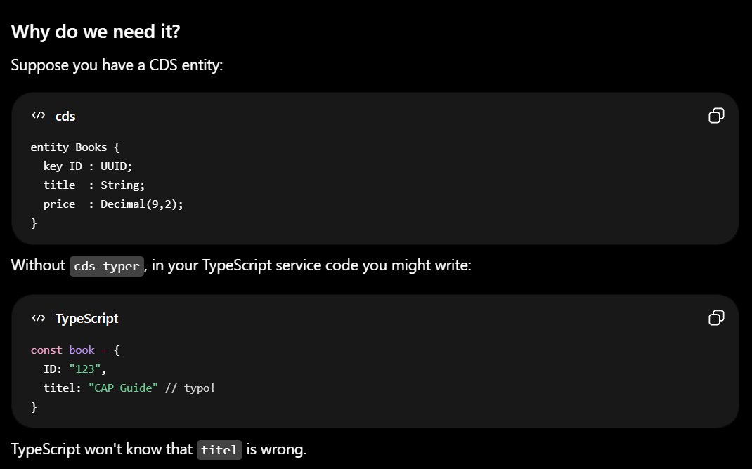
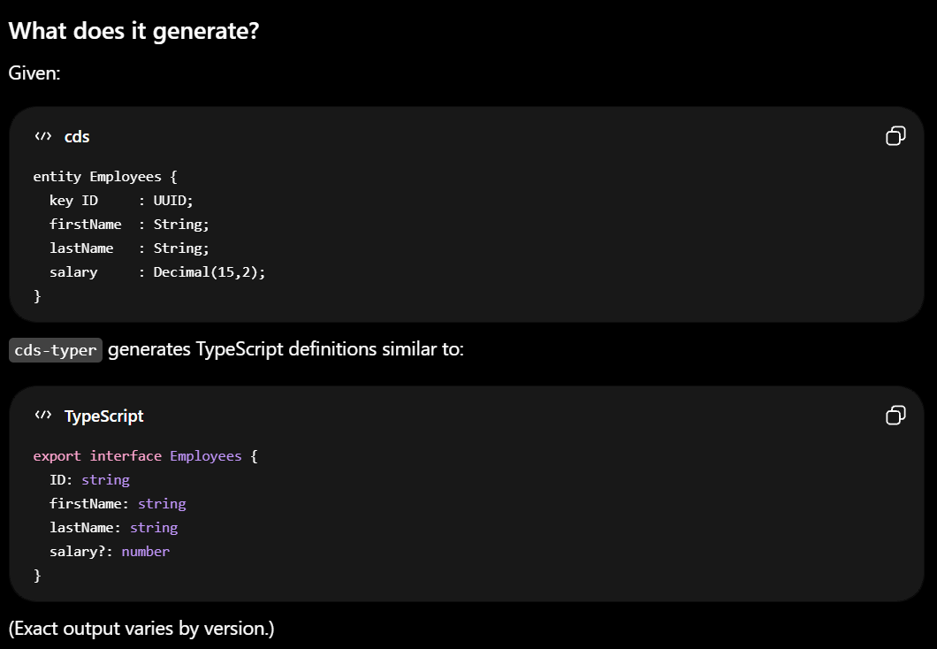
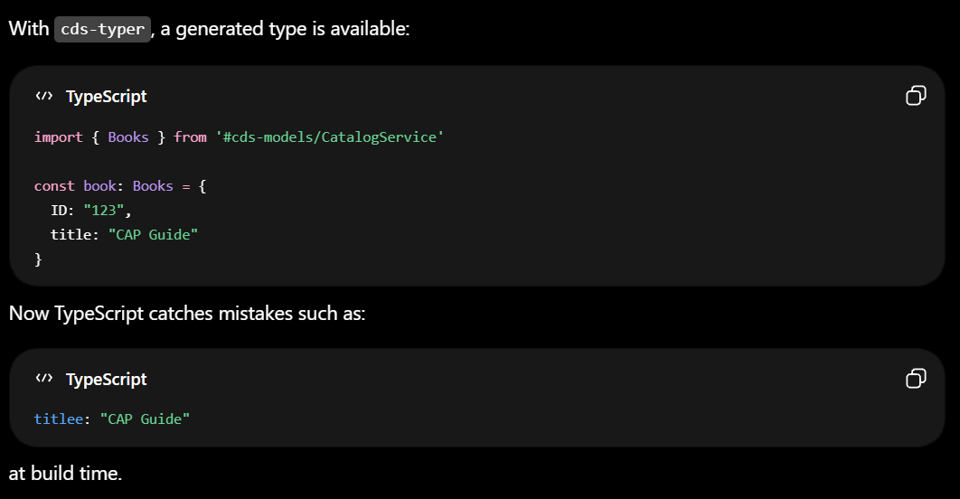
Title
cds-typer is a tool in the SAP CAP (Cloud Application Programming) ecosystem that generates TypeScript type definitions from your CDS models.
In simple terms
You write your data model in .cds files, and cds-typer automatically creates TypeScript interfaces/types so your code gets autocomplete, compile-time checking, and fewer runtime errors.
7
www.anubhavtrainings.com
7

Slide 50
Does cds watch convert my ts code to js?
Short answer: cds watch runs your TypeScript directly — it does not write .js files
There's no hidden compile-to-disk step. Your srv/ folder stays .ts-only (you saw that — no .js siblings appear), and nothing emits a CatalogService.js.
How it actually works
The magic is tsx (it's in your devDependencies). Here's the chain:
cds watch starts the CAP server. Because TypeScript is set up (tsx installed + CAP's CDS_TYPESCRIPT handling), CAP registers the tsx loader into Node.
tsx hooks into Node's module loading. Every time a .ts file is required/imported (your CatalogService.ts, CDSService.ts, the utils), tsx transpiles it in memory using esbuild and hands the resulting JavaScript straight to Node.
That transpiled JS lives only in memory for that run. The moment the process stops, it's gone. Nothing is written to disk.
So it's "run TS directly" in the practical sense — but technically every .ts is still being turned into JS on the fly, just in RAM instead of as files. (Node itself can only execute JavaScript; tsx is the invisible translator.)
The one thing this means for you
Transpiling ≠ type-checking. tsx/esbuild is fast because it only strips the types — it does not verify them. So cds watch will happily run code that has type errors. That's by design.
This is exactly why you keep two separate gates:
Command Tool What it does Emits .js?
cds watch tsx / esbuild runs the app (strips types, in-memory) ❌ No
npm test ts-jest runs tests (strips types, in-memory) ❌ No
npx tsc --noEmit tsc checks types only (your safety net) ❌ No (--noEmit)
All three transpile/analyze TypeScript, none of them leave .js files behind. tsc --noEmit is the only one that actually validates your types — so keep running it before commits, since neither cds watch nor the tests will catch a type mistake on their own.
Quick way to prove it to yourself
Run cds watch, then look in srv/ — you'll see only .ts and .cds files, never a generated .js. If CAP were compiling to disk, you'd find a gen/ or dist/ folder full of .js; you won't.
7
www.anubhavtrainings.com
7

Slide 51
Title
Text
7
www.anubhavtrainings.com
7

Slide 52
Title
Text
7
www.anubhavtrainings.com
7

Slide 53
Title
Text
7
www.anubhavtrainings.com
7

Slide 54
Title
Text
7
www.anubhavtrainings.com
7

Slide 55
Title
Text
7
www.anubhavtrainings.com
7

Slide 56

What We Did
Let’s Summarize
www.anubhavtrainings.com

Slide 57
www.anubhavtrainings.com
Thank You
End of Day 1
www.anubhavtrainings.com

Slide 58


We’re committed to empower you to be
#FutureReady
through powerful training solutions.
We build the workforce of the future.
250+
Corporate Clients
30,000+
Learners Trained
25000+
Learners Placed
FREE WEBINARS
Sign up for free webinars with industry experts every fortnight!
Enroll Now!
Contact us today!
https://anubhavtrainings.com

